Slide 1

Applied Legal Skills
Preview
Ben Alba
Professor of Legal Practice
Director of Academic Success
balba@depaul.edu

Slide 2
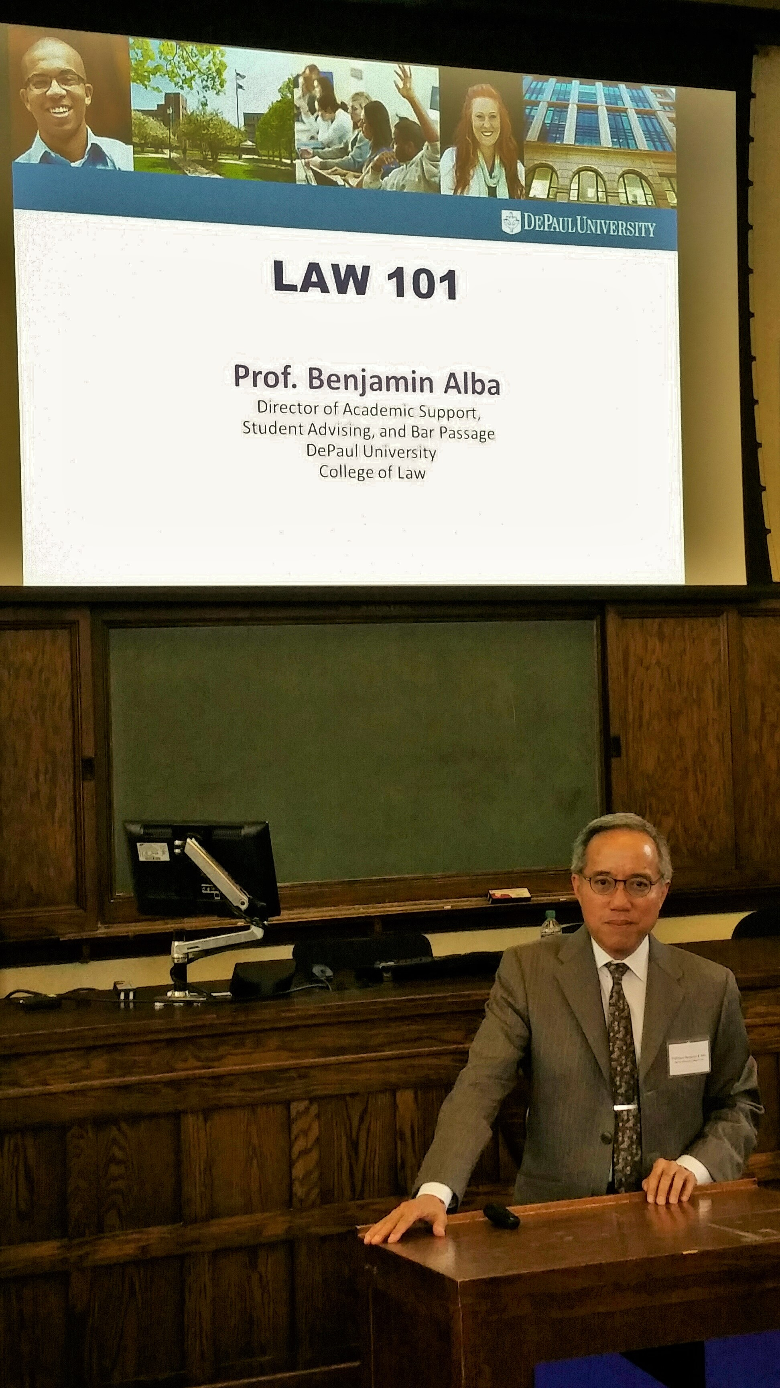
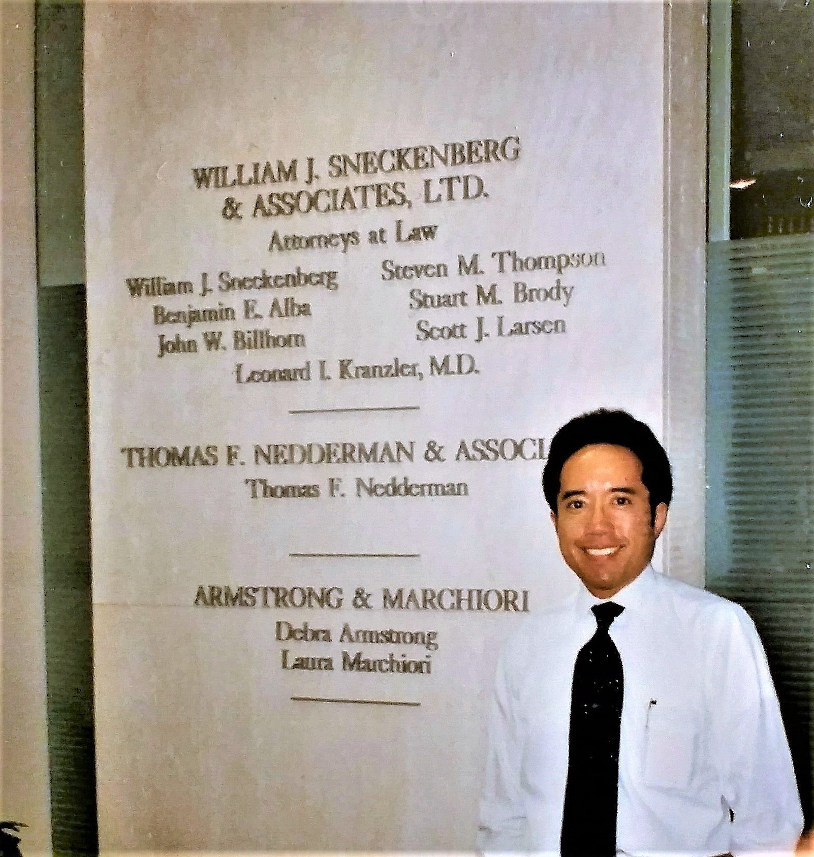

Slide 3
ALS Skills
Deconstructing rules
Rule synthesis
IRAC
Rule application
Time management
Outlining
MCQs

Slide 4
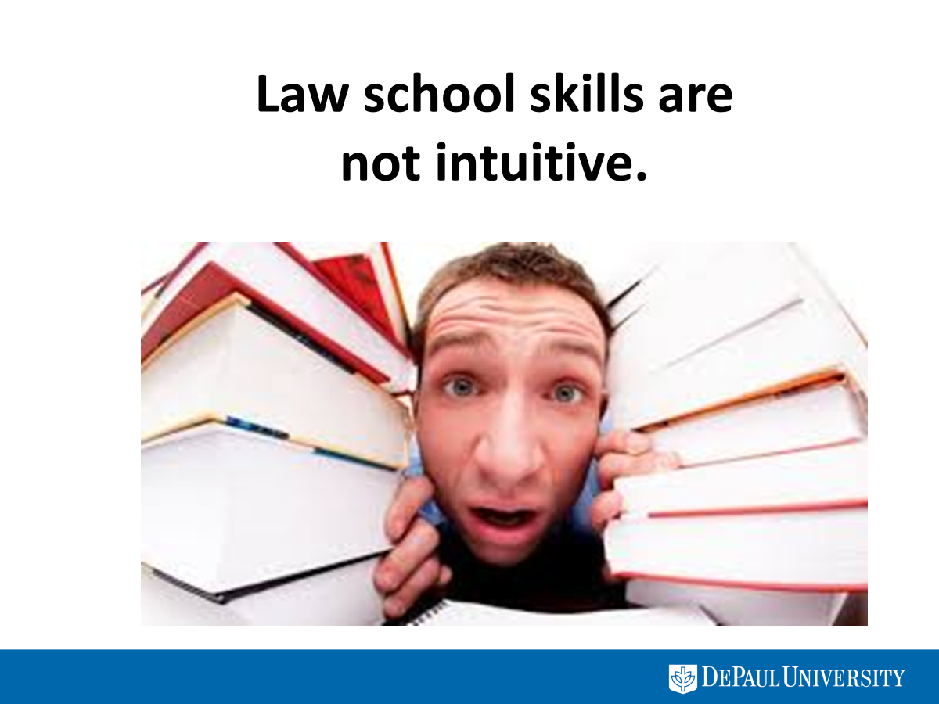

Slide 5


Slide 6
Element 1: breaking
    There was a breaking b/c Smith nudged the door to get inside the study. If the slightest movement of a door is sufficient to amount to a breaking, this element is satisfied b/c Smith intentionally moved into the study by nudging the door.
    CONTRA: Nudging a half-open door does not amount to breaking. Smith did yell, “Mind if I go into the study for awhile?” but got no response b/c homeowner wasn’t paying attention. But Smith knew homeowner was outside doing yard work; thus, his attempt to obtain permission not convincing.

Slide 7
Elements 2 and 3: entering the habitation of another
    Smith did enter the habitation of another b/c he was inside a home that did not belong to him.
    Homeowner had given him permission to be inside a hallway to hang pictures.
    Smith’s movement into study went beyond scope of permission.

Slide 8
Element 4: intent to commit a crime therein
    Although Smith entered house intending to finish his work, he later looked around the house for items he could steal and sell—that was his intent when he entered the study and found the laptops.
    CONTRA: If any movement of door is sufficient to satisfy breaking, intent is satisfied.

Slide 9
Element 5: act occurring at night
    Smith’s act occurred at night b/c streetlights were turning on at the time he was breaking into the study.
    CONTRA: Streetlights just turning on might suggest dusk, when there was still some light out, so therefore it certainly was not yet night.

Slide 11

How to approach answering an exam question
State the issue.
State the rules of law that apply to resolving the issue.
Connect each element of the rule to the facts to prove to the grader that the element is met or is not met.
State your decision on the issue – you must decide for one side or the other.
Practice = success!

Slide 12
Orientation Week Classes:
Big Picture, Key Insights
Law school learning vs. undergrad
How to prepare for first doctrinal class
How to read and brief cases
How to take notes—before and during class
Consolidating notes after class—why?
Time-managing
law school demands

Slide 13
Autumn Semester Weeks 1 - 5:
Key Law School Skills . . . Running Start
Rule synthesis
IRAC structure
Outlining
Self-assessment
Multiple-choice questions

Slide 14
Autumn Semester Weeks 6 - 9:
Apply Your Skills!
Guided study groups
Tutor
one-on-one’s
Midterms
Legal Writing assignments

Slide 15
Autumn Semester Weeks 10 - 12:
Gear Up for Finals!
Shell outline strategies
In-class practice question
Baby
Bar Exam
ALS Practice Exam Experience

Slide 16
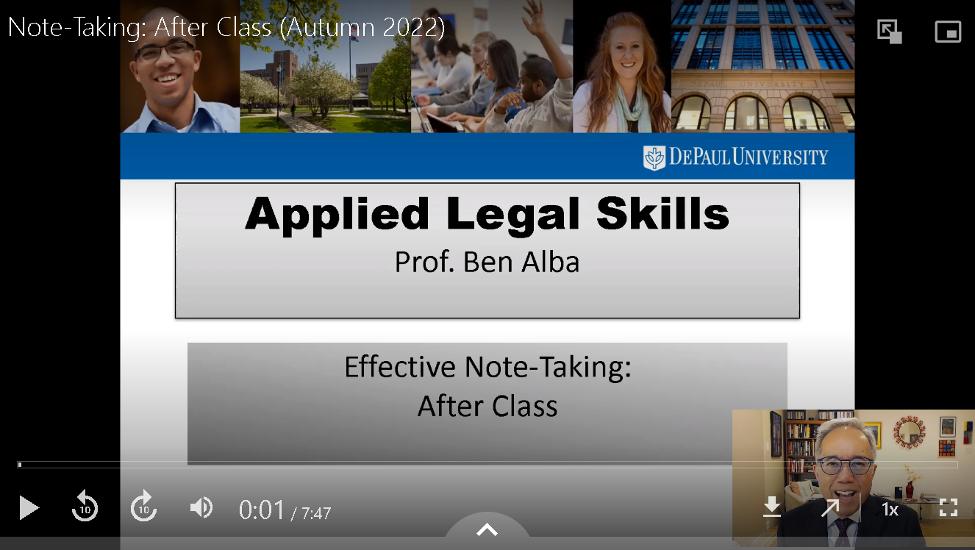

Slide 17
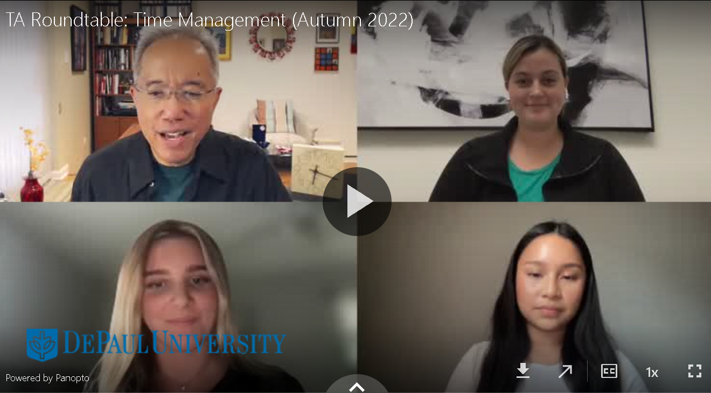

Slide 18


Have a terrific summer!
Prof. Ben Alba
balba@depaul.edu

