Slide 1

Notes:
Now we’re going to talk about DePaul’s Family Law Program of Excellence and the Schiller DuCanto & Fleck Family Law Center works with our family law students within our Program of Excellence.

Slide 2
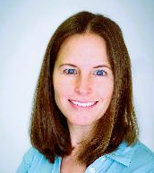
Katie Liss
Assistant Dean & Director
Office of Professional & Career Development

Slide 3
Office of Professional &
Career Development
Our Mission:
Provide individualized advising to help each student to help them clarify their goals and navigate their career path with confidence.
Notes:
The Family Law Center was established in 2003 to work with all of our family law students by providing specialized training within the area of family law and also to promote law reform within family law. DePaul offers several experiential learning opportunities within family law through our Family Law Field Clinic with Chicago Volunteer Legal Services, our Domestic Violence Practicum, externships, and volunteer opportunities.
The Center hosts multiple lectures on current family law issues throughout the year and it also hosts an annual family law symposium in the fall. Our symposium hosts students, professors, as well as practitioners and judges throughout the nation.
The Center also provides students with career counseling and academic support during their time at DePaul.
Every year, the Center selects and provides summer scholarship funding for our 1L Family Law Fellows. All Fellows are selected prior to starting their 1L year after going through an application process. I’ll get into this in more details in a later slide.

Slide 4
Our Team
5 Career Advisors
  Elizabeth Boe – Assistant Director
    Director of Pro Bono & Community Service Initiative
  Tiffany Farber – Assistant Director
    P2P Instructor
  Darrick Harris – Assistant Director
    Assistant Director of Schiller DuCanto & Fleck Family Law Center
  Aarón Siebert-Llera – Assistant Director
    On Campus Interviews & Judicial Clerkships
  Katie Liss – Assistant Dean
    Director of Schiller DuCanto & Fleck Family Law Center
Office Administrator – Kathy Browder
Student Clerks – Parva & Karzeta

Slide 5
1L Preparing to Practice Course
Fall Semester:
  Resumes & Cover Letters
  Networking & Informational Interviews
  Mock Interviews
Spring Semester:
  Professional Identity Formation
  Civility
  Wellness
  Time Management

Slide 6
PCD’s Main Programs
  Practice Area Exploration Fair (Fall)
  General Counsel Speed Networking Reception (Fall)
  Meet the Government Employers (Spring)
  Job Fairs (Spring)
  Judicial Clerkship Panels (Spring)
  Notable Alumni Lunches (all year)
  Career Table Thursdays (all year)

Slide 7
External Job Fairs
  Meet the Public Interest Employers (Fall)
  Equal Justice Works Career Fair (Oct)
  PILI’s Law Student Internship Program (all year)
  Midwest Public Interest Law Career Conference (Feb)
  Cook County Bar Association Job Fair (June)
  Loyola Patent Law Interview Program (June)

Slide 8
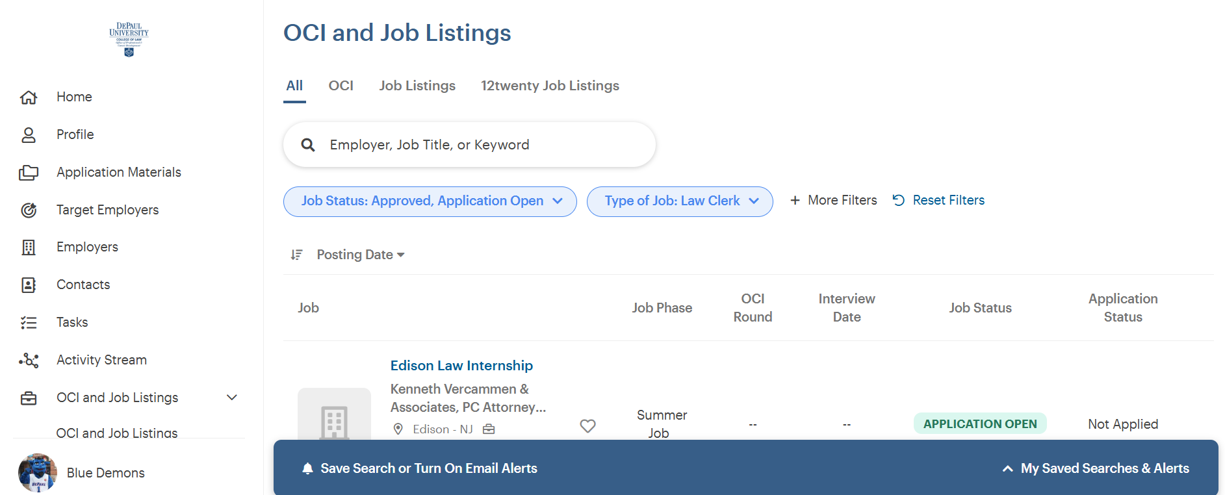
Job Board

Slide 9
Public Interest Law Initiative (PILI) Summer Internships
Summer interns work 400 hours full-time.
Paid $6,500 for their work during the summer, less applicable taxes.
The application period will open for law students at 10:00 a.m. on November 1st for 2Ls and November 15 for 1Ls.
See a full list of PILI’s participating agencies, including position descriptions »

Slide 10
On Campus Interviews (OCI)
Session 1: January (6 employers; 1 offer)
  Cassiday Schade LLP
  Foran Glennon Palandech Ponzi & Rudloff PC
  HeplerBroom, LLC
  Mayer Brown LLP
  SBSB Eastham
  Winston & Strawn LLP

Slide 11
On Campus Interviews (OCI)
Session 2: June (12 employers; 8 offers so far)
  Burke Warren MacKay & Serritella, PC
  Heyl Royster
  Hirzel Law PLC
  Howard & Howard Attorneys PLLC
  Lavelle Law, Ltd.
  MG+M
  Nicolaides Fink Thorpe Michaelides Sullivan LLP
  Nyhan Bambrick Kinzie & Lowry, PC
  Rammelkamp Bradney, PC
  Riley Safer Holmes & Cancila
  Skarzynski Marick & Black LLP
  Will County Public Defender
Session 3: October (TBD)

Slide 12
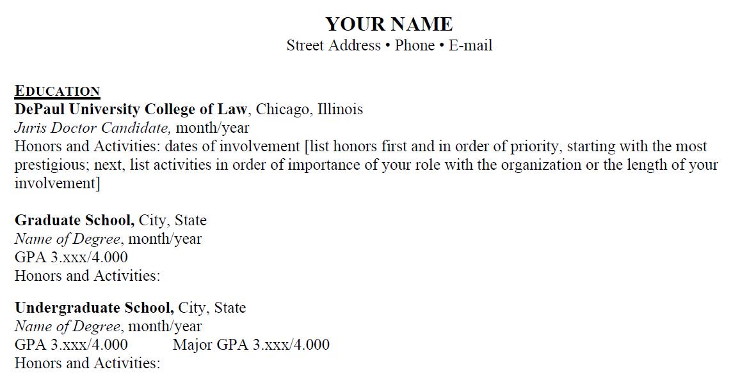
Resume – Part 1

Slide 13
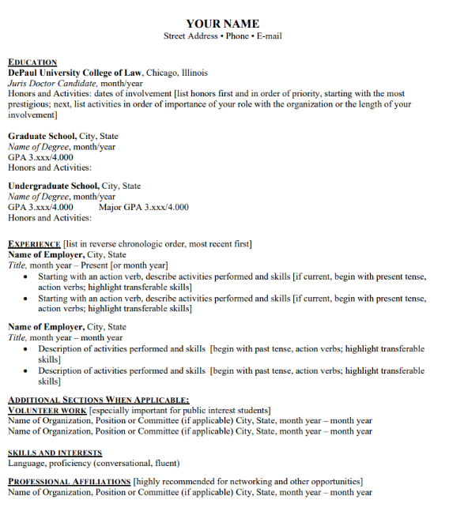
Resume – Part 2

Slide 14
Resume – Part 3

Slide 15
1L Summer Job Search Timeline Recap
Mid-September → start meeting with 1L advisor
Mid-Semester → have your resume finalized by then
October → Big law’s new heavy recruiting season starts
Mid-November → apply for a PILI scholarship if interested in non-profits
Winter Break → use this time to heavily apply for 1L summer positions if you don’t yet have one
January → first OCI session if interested in big law (summer 2028)
February → participate in MPILCC if interested in public interest summer positions

Slide 16


Questions?
E-Mail: kliss3@depaul.edu
Phone: 312/362-8331
Office: Room 305 (3rd floor)
Notes:
If you have any questions, please do not hesitate to contact me. The best way to reach me is via email. When you are on campus, please be sure to stop by my office on the 3rd floor of the law school. Enjoy your summer and I hope to see you soon!

